Slide 1
Phase 1: Blockchain Research
Blockchain Senior Design: Caleb, Megan, Savannah, Timothy, Virginia

Slide 2
Implementing a Simple Blockchain using Python
SHA-256 hashing algorithm to create the block’s hash for fingerprinting.
Each block contains its hash and the previous block’s hash.
Uses proof of work to mine for the next block.
After several blocks have been added it checks the blockchain’s validity.
The web application is made using Flask and can be deployed locally or publicly as needed by the user.
Notes:
I worked on the simulations you sent us with Caleb and getting them up and running and he will be talking about those later on. I also read some of the papers that you sent us along with the article about implementing a simple blockchain using python which I will be talking about.
The article talked about using a SHA-256 hashing algorithm…
Each block in this simulation contains its own hash and the previous block’s hash
It uses proof of work to mine for the next block
After several blocks have been added to the chain it checks for the blockchain’s validity
Then finally it makes a web app using Flask that can be deployed locally or publicly as needed by the user.

Slide 3
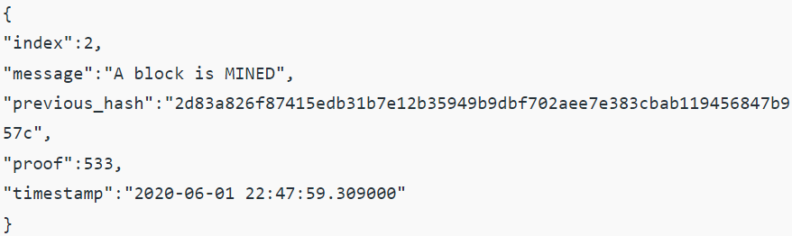
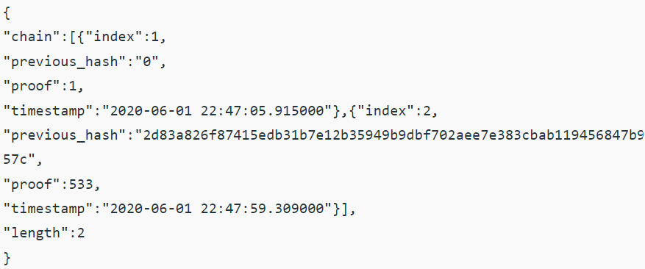
Simulation Code Output:
Notes:
The screenshots provided are outputs that are produced by the code.
The first screenshot shows what is output after a block is mined. It shows the block’s number/place in the blockchain, the time it was created, and the hash of the previous block.
The second screenshot shows details of the blockchain. You can see how many blocks are in the blockchain, and how the second block contains the previous block’s hash where the first block doesn’t have a previous hash because it is the first block in the blockchain. If more blocks were added after the second block you would continuously be able to see the hash of the previous block.
The last screenshot shows the message that would be displayed after several blocks have been added and the validity of blockchain would need to be verified.

Slide 4
Proof of Authority
Used in a permissioned blockchain and requires all nodes to be pre-authenticated.
Nodes can create a new block if they have proven their authority to do so.
Needs less computational power, rate at which blocks are created is predictable, high transaction rate, and requires 51% of nodes to be compromised in order to go down.
Implementing it into our simulation:
Calculate the leading node: leader = ((time - first) / step) % nodes
New block is generated by the leader node and the leader role is passed to the next “validator” node from the list of authorized nodes.
Block is validated
Fork - longest blockchain rule
Notes:
Implementing in our simulation:
Calculate to find the leader node.
Each new block will be created by the new designated leader from the list of authorized nodes.
The block will be created by collecting new transactions from the queue and executing them or rejecting them if invalid, then checks compliance for the block generation limits, creates a block with valid transactions and signs it with the node’s private key (ECDSA algorithm), and finally sends the block to other validating nodes.
The block is validated: Other nodes receive the new block and confirm it was created correctly, then they execute the transactions and check that they are executed within the block generation limits, if it’s successful the block is added to the node’s blockchain and if it fails it is rejected and sent with a “bad block” transaction message. If the node that created this block continues to make bad block it can be banned or excluded from the validator node list.

Slide 5
Proof of Authentication
Used in a permissioned network with resource constrained distributed systems.
Uses minimal resources, requires less time, reduces unstable network connectivity, and only trusted peers can authenticate.
Implementing it into our simulation:
To start all nodes follow SHA-256 hash and each node has private and public keys.
The nodes combine the various transactions to form a block.
The nodes then sign the block with their private key and broadcast the block to the network.
The trusted nodes will then verify the signature with the source public key.
If the block is authenticated, the trusted node will broadcast the block for the other nodes to add to their blockchain.
If the block is not authenticated, it will be dropped.
Notes:
Perfect for our IoT environment

Slide 6
Practical Byzantine Fault Tolerance
There is a primary node and other secondary nodes, and any node can become the primary node.
No more than ⅓ of the nodes in the system can be malicious and with more nodes the system becomes more secure.
It is energy efficient, does not require multiple transaction confirmations, and all nodes take part in handling client requests.
Implementing it into our simulation:
A proposer is elected and it collects transactions from the transaction pool, creates a block proposal and broadcasts it to the network as “pre-prepared”.
Validators receive the proposal and verify the proposal and broadcast it to other validator nodes as “prepared” and broadcast commit messages.
Validators wait for commit messages and then enter into the committed state where the messages are received and add the block into the blockchain.
After the block is added, the validators enter the final state where it is finished and will begin the new round.
Notes:
Primary (or leader nodes) and secondary (or backup nodes). Any node can become the primary node the other nodes will just need to come to the same conclusion about which node will become the primary.
On the other hand, it is susceptible to Sybil attacks where one entity controls multiple identities. But as the number of nodes increase it becomes harder for this attack to be successful.
pBZT also does not scale well because of the communication that takes place between nodes.
A proposer will send out a broadcast message with the proposed block which will then be broadcasted to all the other nodes.
Each node will then send back a prepare message if it agrees with the proposed block. Once all nodes agree the nodes change their state to prepared.
The prepared nodes will send commit messages to each other as they add the block to the blockchain.
After the block is added, they move to the final state where they will select a new proposer node and begin the process again.

Slide 7

Simulation Demo & Results

Slide 8
Timothy’s Discussion on Blocks
Goal: To build a trusted blockchain without using permissioned blockchain. By applying cybersecurity standards and known malicious behavior, we will integrate security into the blockchain and remove untrustworthy nodes.
Basically, if node is untrustworthy:
Don’t add its data to the blockchain
Remove all traces from newest block
Mark as untrustworthy
Uses Smart Contracts
Before running, check if contract is revoked
Used to detect, deter, and defy malicious devices
Notes:
A permissioned blockchain has a central authority managing the nodes. We want a decentralized system of node trustworthiness.
We want permissionless so devices can come and go at their leisure and not have to be recertified/repermissioned every time they want to rejoin.
Megan may go over Smart Contracts - suggestion: each contract goes through lst block looking at contract ID revocation list
Revocation of contract requires signatures of all parties involved and validation of entire blockchain.
Thoughts on smart contracts:
Punishment if a device tries to use the public key of another device
Automatic ban: trying to ARP spoof a persistent device

Slide 9
Smart Contracts
Smart contract vulnerabilities: Praitheeshan, Purathani, et al. "Security analysis methods on ethereum smart contract vulnerabilities: a survey." arXiv preprint arXiv:1908.08605 (2019).
For Ethereum, programmed in Solidity
Use newest version
Use tools discussed in article to design and test
Most smart contracts not built for all possible scenarios of exploitation
Like needing mutexes and sending money out before checking the balance.
Smart contracts will search transactions for indicators of malicious activity
Smart contracts will inform devices to not trust devices it finds malicious
Would need to be aware of false positives?
Would this need an appeal system to fix issue?

Slide 10
Block Security
Read paper on public key cryptography in blockchain (PoAuth)
Can be used for security and authenticity
Options for distributing public key:
When node joins, public key broadcasted to nodes in network
Next block has the new node’s public key and all updated keys in newest recent block
Options to verify:
Digitally sign current transaction
Redundant transaction that is digitally signed
Saves time decrypting signature
Signed transaction input → verified transaction in block:
If digital signature legitimate, add
Validators take slightly more time to process
When device leaves network, remove key from list of public keys:
Option: Either key manager on each device, store public keys in xml file, or just pull from blockchain.
Notes:
Provides security and authenticity because impossible to determine private key from public and used for digital signature
There are options for how to distribute the key to the network/blockchain
Either send it out manually, or keep most up to date key list in last block of blockchain

Slide 11
Block Size
There are trade-offs between scalability and decentralisation. For example, a larger block size would allow the network to support a higher transaction rate, at the cost of placing more work on validators — a centralisation risk.
–Enabling Blockchain Innovations with Pegged Sidechains, 2014
Tradeoff between larger and smaller blocks leading to differing capacity
Unfeasible to collect all network traffic, so store portion of traffic in blockchain:
Important messages: ICMP, ARP, TELNET, etc.
Any additional messages/protocols to always record, like ssh connections/teardowns?
Tcpdump plugin or continually running packet capture from persistent device
Goal is to save messages that will identify patterns similar to cyberattacks
Need to size collection window correctly to optimize for speed and bandwidth
Either window of time for transactions or fixed number/size of transactions per block
Any suggestions on size or should we set an initial time and modify based on performance?
Notes:
The goal is to decentralize the system, so we want to lower the block size so any device could theoretically verify it.
Could have more packets that could be sent, but all devices would be slowed down when processing.

Slide 12
What goes in a Block?
A Block consists of:
Index
Timestamp
Block hash
Previous block hash
Transactions
Are transactions made from a packet dump of network traffic?
Selective packet transmissions - ARP messages, dissociation frames, & ICMP msg
Invocations of smart contracts - results added to most convenient immediate block
Any new smart contracts
All smart contracts for defense located in first/second block for easy access. Only original node can create removal contracts unless updates made
Addition of members - maybe updated list of members?
Updated list of public keys
Notes:
What other network transmissions could indicate behavior of an attacker? What packet transmissions are suggestive of evil behavior
Invocation of smart contracts, like for defense of network, so other nodes know who the target of the contract was
Just basic format for the idea of a block’s contents

Slide 13
Proposed Block Contents:
Standard elements:
Index
Timestamp
Current block’s hash
Previous block’s hash
Data:
Smart Contracts:
Revocation of old contract - requires digital signature of all parties
All instances of smart contract invocation and target
For defense: when device was removed from list of approved devices
Prevent changing of IP by blacklisting MAC address.
Further deter by comparing new device’s behavior to that of previous device
New contracts
Active Members list
Includes new members
Malicious members list
MAC address and IP
Updated list of member’s public keys
Data transmissions:
What do we want for transactions - ARP messages, dissociation frames, and ICMP messages
Other relevant packets i.e. ssh or connection to persistent devices
Notes:
Based on my research and our application of blockchain, this is my proposed content for a block in the blockchain

Slide 14
Networking
Goal: “Instead of relying on traditional cloud data centres, blockchain interconnects computer nodes, including virtual machines on cloud and external computers, to build a fully decentralized storage system without requiring a central authority.”
Source: “Integration of Blockchain and Cloud of Things: Architecture, Applications and Challenges” by Nguyen, Pathirana, Ding, & Seneviratne

Slide 15
Network Rules
Qualifications:
“eliminating the requirement for a trusted third party
…peer-to-peer architecture …
“most important feature is decentralization… not rely on a central point of control to manage transactions”
allows all network participants to verify …
equal validation rights.”
“capability to create,
authenticate and
validate the new transaction to be recorded in the blockchain”

Slide 16
Network Questions
What quantity of data will we be handling?
“In largescale blockchain applications, the number of transactions… can be enormous… necessary to provide powerful data processing services… the cloud can offer on-demand computing resources for blockchain operations thanks to its elasticity and scalability”
Concern - “Many current blockchain systems suffer from high block generation time which in turn reduces the overall blockchain throughput. Further, if all transactions are stored in a chain, the blockchain size will become very large”
“public (or permission-less) and private (or permissioned) blockchain”?
“private blockchain is an invitation-only network managed by a central entity and all participations in blockchain for submitting or writing transactions have to be permissioned by a validation mechanism”

Slide 17
Network Actors (simulated)
Phone, tablet:
“holds a blockchain account (like a wallet in Bitcoin)...join the blockchain network to perform transactions …resource-limited …lightweight node that can participate in the validation process of a transaction. All interactions… with blockchain… are performed by the gateway”
Computer:
“serve other lightweight IoT sensors and maintain the full blockchain. …interact … through IoT gateways to achieve corporative communication (e.g., device to device (D2D) communication in collaborative networks)...
hybrid communication concept”
Cloud
Data aggregated by IoT gateways… received… and kept in the cloud blockchain storage
Shared ledger, consensus, smart contract, cryptography
Transforms idea to ‘blockchain as a service”

Slide 18
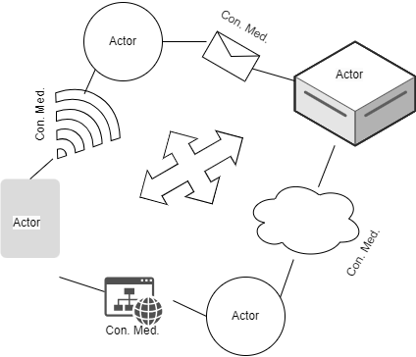
Network structure
Actors
Connection medium - “network of computing servers which are interconnected robustly by collaborative clouds”
(“the inter-cloud ecosystem can enable the blockchain system to operate continuously”)
Mechanisms: “data block, distributed ledger, consensus, and smart contracts.”
Some mechanisms are also items
Sent, stored, and/or executed
Using the cloud for all CMs
=
“joint cloud collaboration environment where multiple clouds are interconnected securely by a peer-to-peer ledge network”

Slide 19
More on Network mechanisms
Distributed ledger (database) - “same copy of records of blockchain spreads across … all blockchain users can fully access, verify and track transaction activities over the network with equal rights”
consensus (verification)
smart contract - build logic & trust, self executing, access authentication, data sharing confirmation
cryptography (public key)

Slide 20
Novel concepts
distributed side blockchains
fog nodes
Mediary before cloud
Multi-blockchain
applied to integrity evaluation
two-layer blockchain - integrity focus
data validation layer
PoW task layer
integrated with IaaS cloud
Micro-clouds
Ubuntu Linux microcloud

Slide 21

Smart Contracts
Pieces of code, automation
Store, verify, execute rules
“Vending Machine” (conditional)
Immutable, distributed, deterministic
Resides in the blockchain, triggered by call to its address
ethereum/solidity
Notes:
Etherscan - platform to see details and stats on ethereum
Because the miners do not form an identifiable set, they cannot have discretion over the rules determining transaction validity. Therefore, Bitcoin’s rules must be determined at the start of its history, and new valid transaction forms cannot be added except with the agreement of every network participant. Even with such an agreement, changes are difficult to deploy because they require all participants to implement and execute the new rules in exactly the same way, including edge cases and unexpected interactions with other features
-Enabling Blockchain Innovations with Pegged Sidechains, 2014

Slide 22
Security Analysis Methods on Ethereum Smart Contract Vulnerabilities - A Survey
“The combination of vulnerabilities in Ethereum blockchain and Solidity programming language makes the security checks more challenging in smart contracts development”
Many different potential vulnerabilities
Tools to assist
Mitigate through testing and good practices

Slide 23
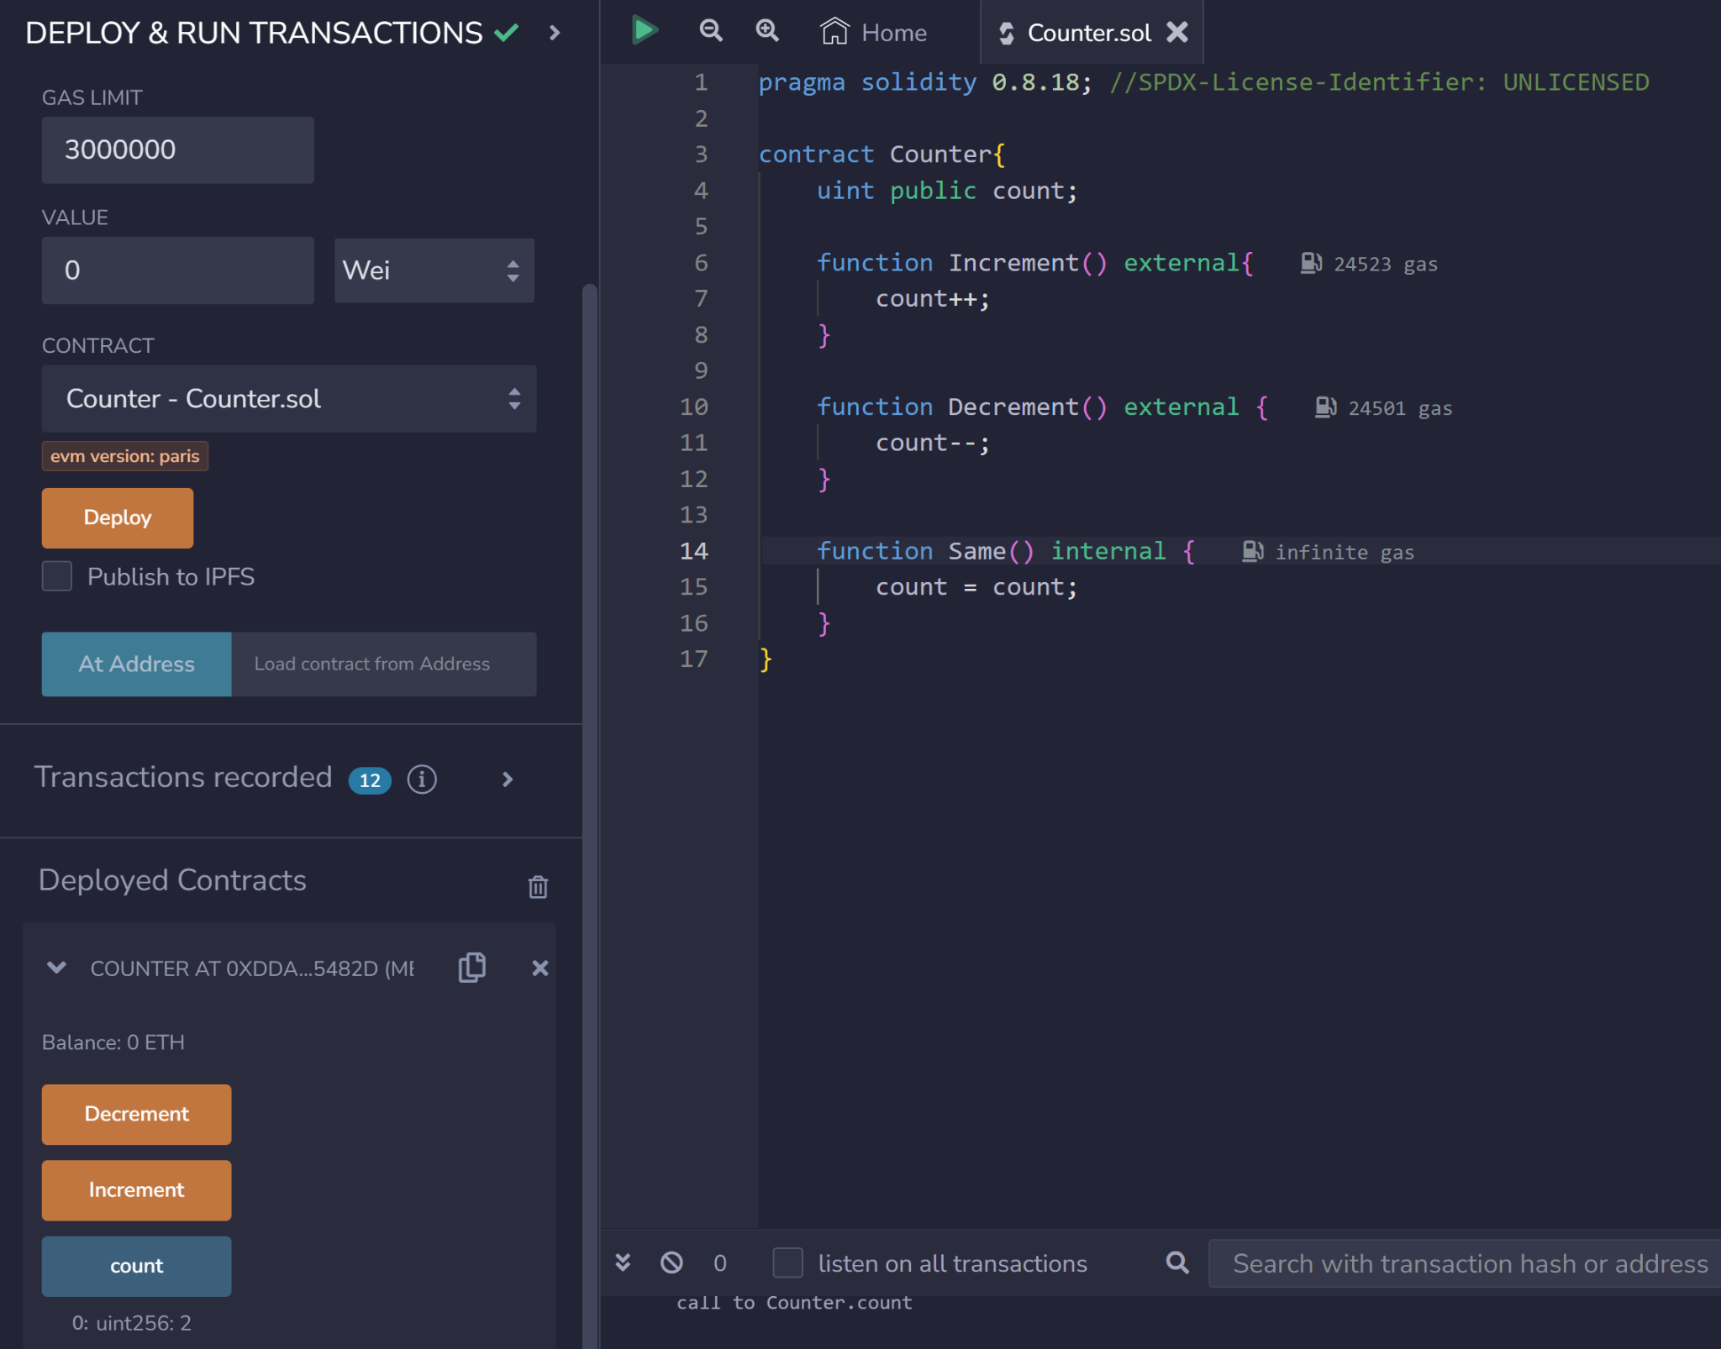
remix.ethereum.org
Online IDE to create and test Smart Contracts on a simulated network
internal/external
Uint256
public/private

